Slide 1
Shoreline site set-up, logistical and decontamination issues
CGPRT(W) : Ensuring Clean Seas and Coasts in Western Region ……

Slide 2
Objective
To understand the operational aspects of shoreline site set-up including logistical and decontamination issues.
CGPRT(W) : Ensuring Clean Seas and Coasts in Western Region ……

Slide 3
Logistics
Provides the equipment and services allowing the response effort to function on a daily basis.
The supply chain that logistics maintains keeps the spill response operations functioning.
CGPRT(W) : Ensuring Clean Seas and Coasts in Western Region ……

Slide 4
Logistics
Responsible for:
Communications
Medical support to incident personnel
Food for incident personnel
Supplies
Facilities
Ground support
CGPRT(W) : Ensuring Clean Seas and Coasts in Western Region ……

Slide 5
Logistics
Logistics ensures that the proper supplies and equipment are available.
This is a major task and must be done in order for operations to begin.
Example: Personnel need PPE before work can begin.
Example: Vessels need to refuel regularly to continue operations.
Example: Operations needs boom and all related boom accessories to protect.
CGPRT(W) : Ensuring Clean Seas and Coasts in Western Region ……

Slide 6
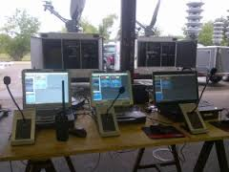
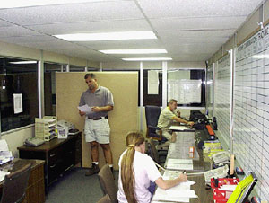
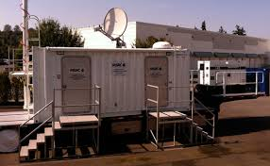
Supply Chain
Communications
Distributes and maintains communications equipment
CGPRT(W) : Ensuring Clean Seas and Coasts in Western Region ……

Slide 7

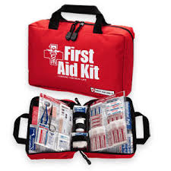
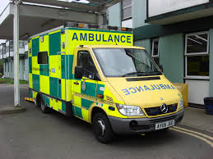
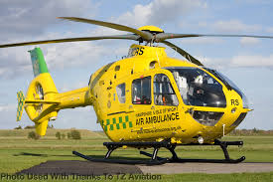
Supply Chain
Medical
Provides first aid and light medical treatment services and equipment
May need to de-contaminate
CGPRT(W) : Ensuring Clean Seas and Coasts in Western Region ……

Slide 8
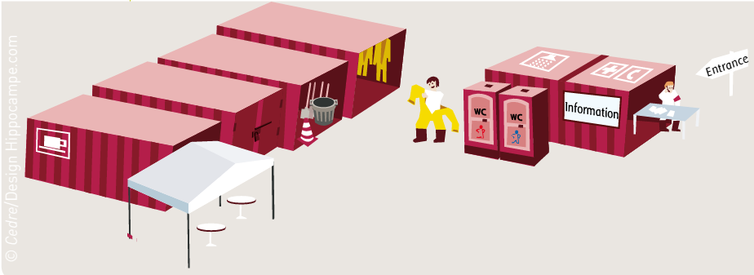
Supply Chain
Food
Food and potable water
Obtains equipment and supplies to operate food service facilities
Source: CEDRE
CGPRT(W) : Ensuring Clean Seas and Coasts in Western Region ……

Slide 9
Supply Chain
Supply
Assists in determining the type and amount of supplies needed to support the incident
Orders, receives, stores and distributes supplies
Services equipment
Places all resource orders
Maintains inventory of supplies and equipment
CGPRT(W) : Ensuring Clean Seas and Coasts in Western Region ……

Slide 10
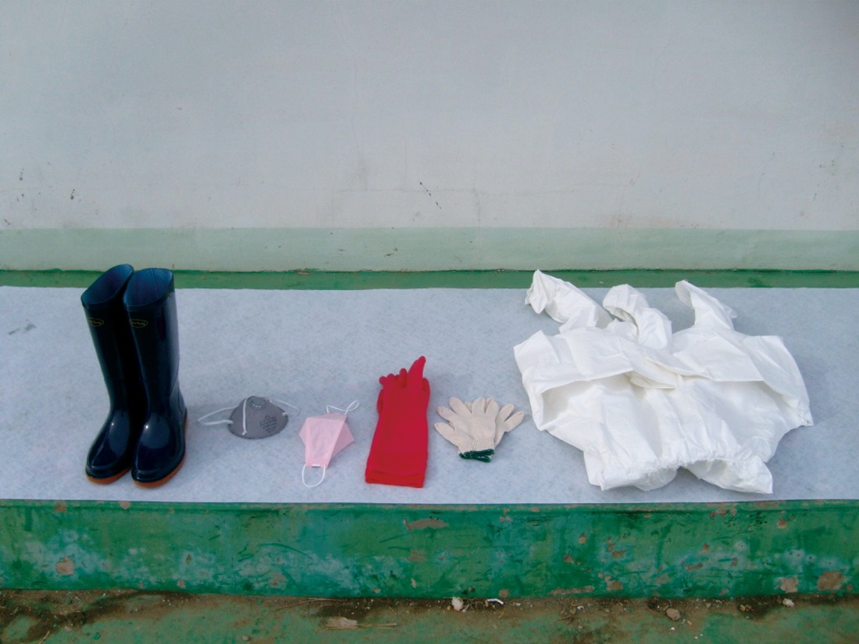
Supply Chain − Support Branch
Facilities unit
Sets up and maintains facilities
Provides managers for base and camps
Provides facility security and maintenance services (sanitation, lighting, clean-up, decontamination supplies)
Source: Korea Coast Guard
CGPRT(W) : Ensuring Clean Seas and Coasts in Western Region ……

Slide 11
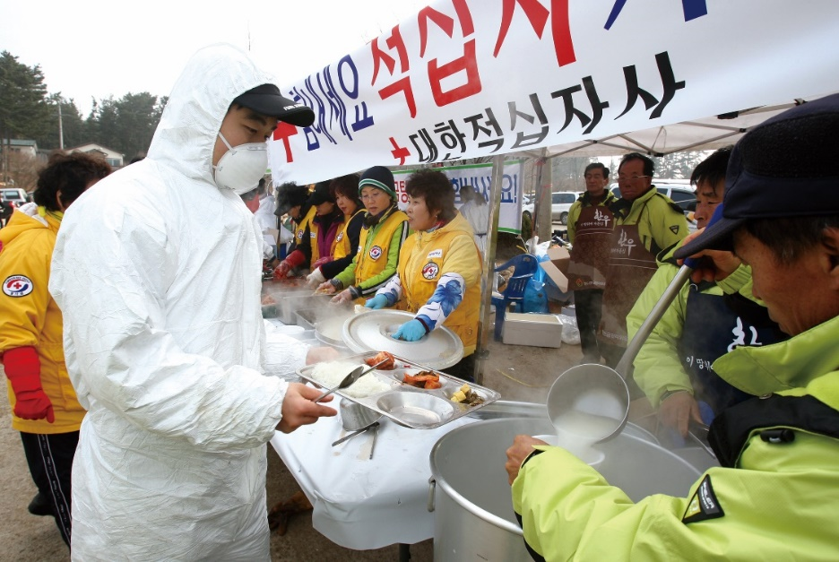
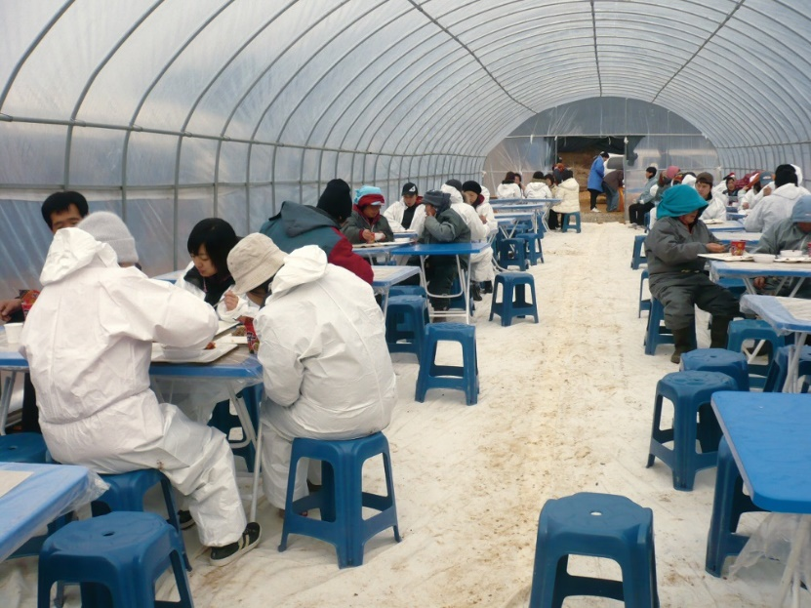
Supply Chain
Ground support
Arranges for and documents the fueling and maintenance of ground resources
Arranges for transportation of personnel, supplies, food and equipment
Source: Korea Coast Guard
Source: Korea Coast Guard
CGPRT(W) : Ensuring Clean Seas and Coasts in Western Region ……

Slide 12
Staging Area
Temporary location where equipment, personnel and other resources are staged while waiting for tactical assignments
Strategically located to supply the response operations
Typically close to response operations (may be limited by access to property, physical geography, etc.)
CGPRT(W) : Ensuring Clean Seas and Coasts in Western Region ……

Slide 13
Staging Area
Requires a large, flat area with access for equipment such as boats, heavy machinery, spill equipment, rest facilities, parking area, etc.
A decontamination area where oiled personnel and equipment can be cleaned/disposed of
CGPRT(W) : Ensuring Clean Seas and Coasts in Western Region ……

Slide 14
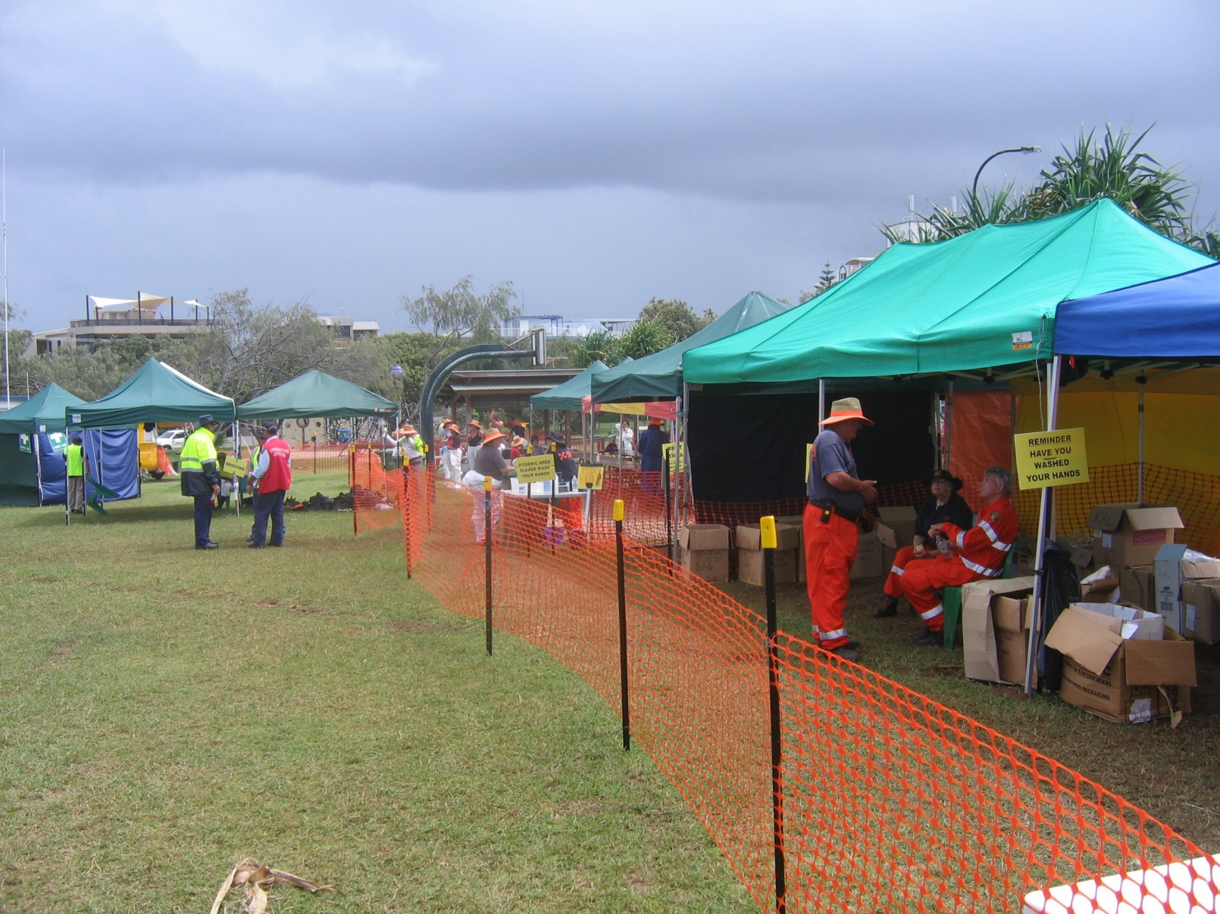
Staging
Source: ITOPF
CGPRT(W) : Ensuring Clean Seas and Coasts in Western Region ……

Slide 15
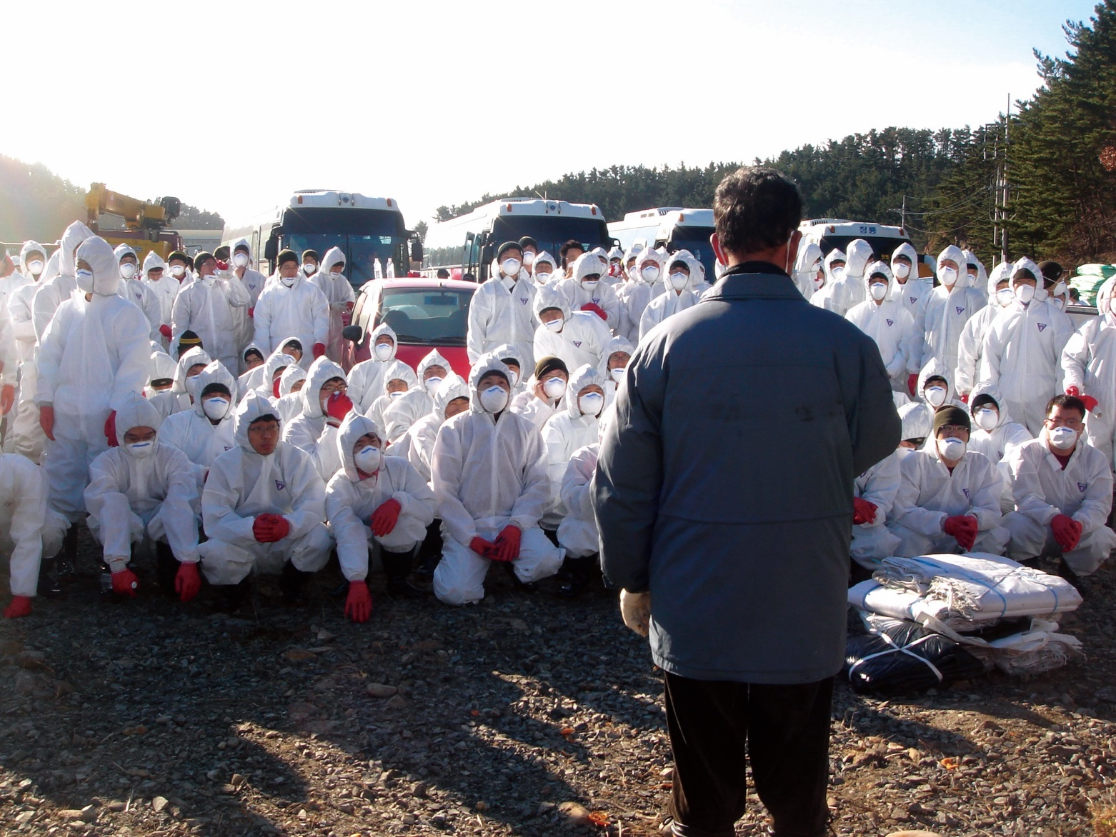
Daily Briefing
Source: Korea Coast Guard
CGPRT(W) : Ensuring Clean Seas and Coasts in Western Region ……

Slide 16
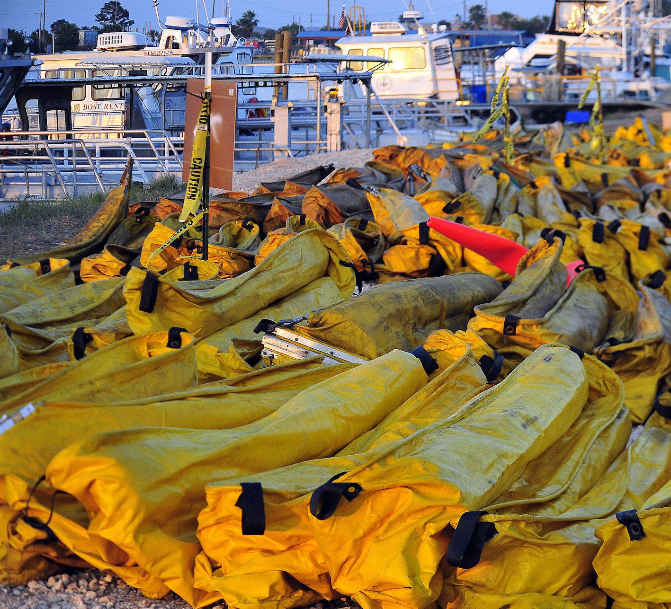
Staging
Source: Korea Coast Guard
CGPRT(W) : Ensuring Clean Seas and Coasts in Western Region ……

Slide 17
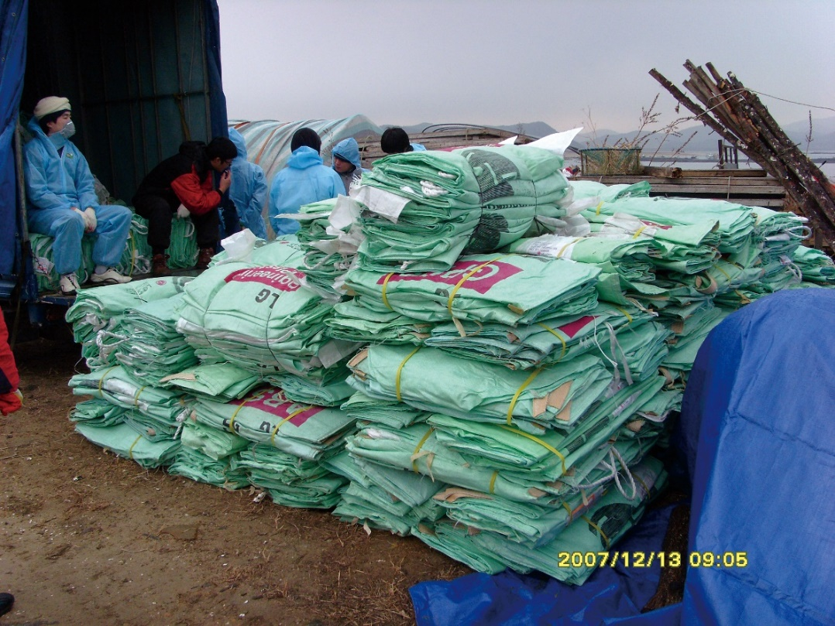
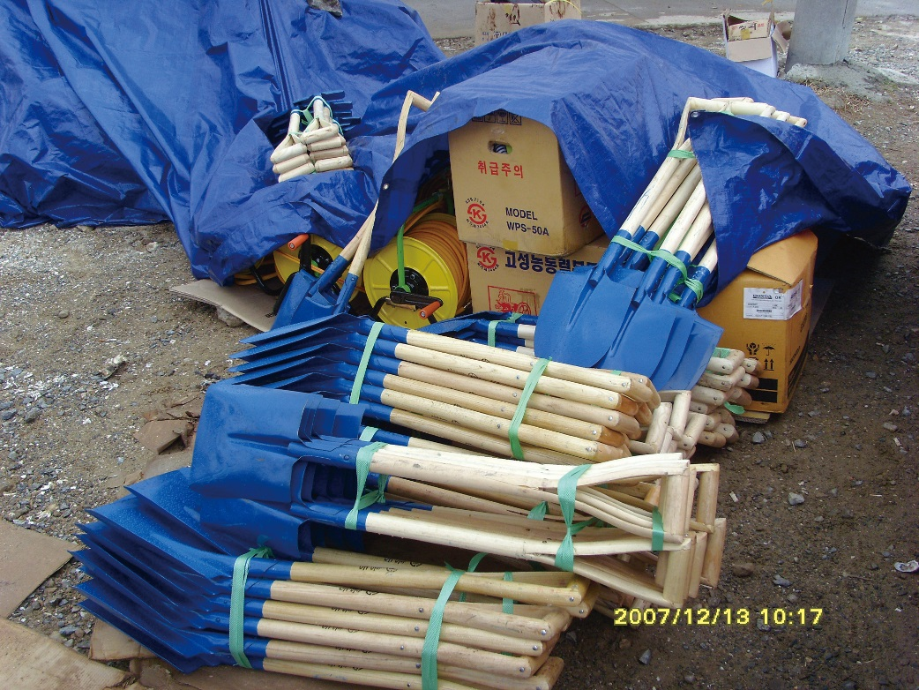
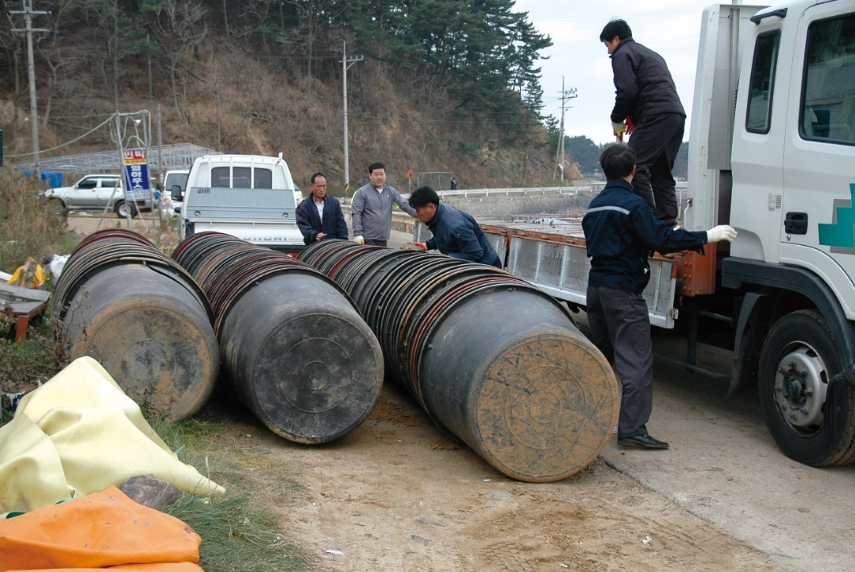
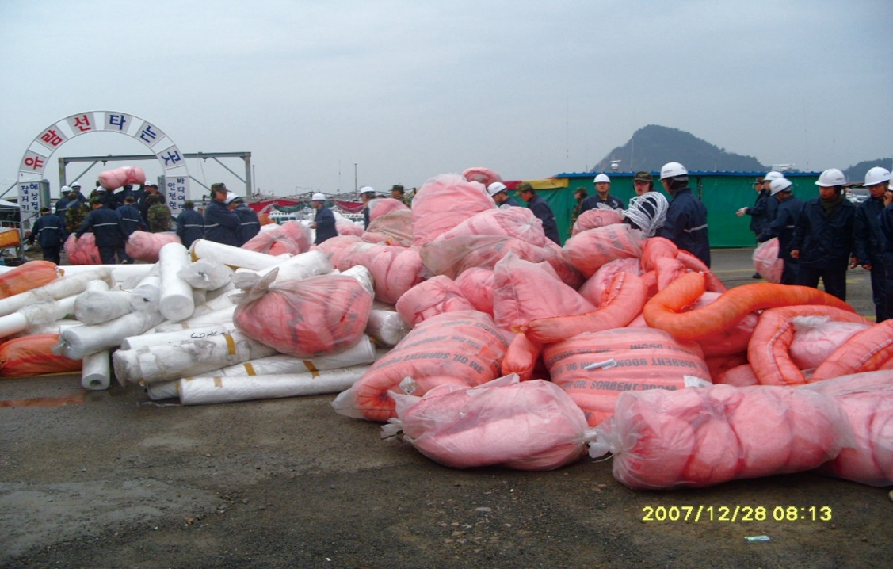
CGPRT(W) : Ensuring Clean Seas and Coasts in Western Region ……
Source: Korea Coast Guard

Slide 18
Decontamination
Part of the Health and safety plan
Critical for the health and safety of response personnel
Critical to avoid secondary contamination by response personnel or other spill vehicles and vessels
Logistics procures the decon supplies and equipment
CGPRT(W) : Ensuring Clean Seas and Coasts in Western Region ……

Slide 19
Decontamination
Personnel
Vessels
Vehicles, i.e. trucks, ATVs
Heavy equipment
Spill equipment
Skimmers
Boom
Pumps/hoses
Storage tanks
CGPRT(W) : Ensuring Clean Seas and Coasts in Western Region ……

Slide 20
Decon Plan
Description and location of decon facilities
List of decon equipment required
PPE for the personnel doing the decon
Decon procedures for specific materials
Procedures to prevent secondary contamination
Procedures to prevent secondary contamination for personnel removing oiled PPE
CGPRT(W) : Ensuring Clean Seas and Coasts in Western Region ……

Slide 21
Decon Plan
Safe disposal methods for various materials that cannot be decontaminated, i.e. disposal coveralls, gloves, sorbents
Revisions for changes in site conditions
CGPRT(W) : Ensuring Clean Seas and Coasts in Western Region ……

Slide 22
Decon Facilities
Decon should be done in stages, moving either from a cold zone (clean, support), through a warm zone (contamination) to a hot zone (exclusion) or vice versa
Hot Warm Cold
CGPRT(W) : Ensuring Clean Seas and Coasts in Western Region ……

Slide 23
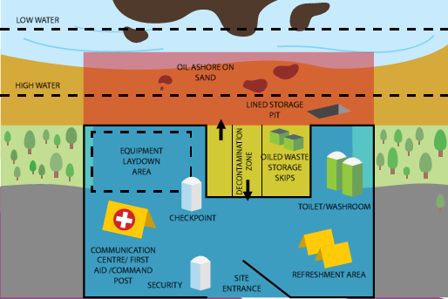
Decontamination Facilities
Hot Zone
Dirty/work area: all oil stays in this zone
Warm Zone
Clean down area: Controlled entrance/exits with decontamination
Cold Zone
Waste removal vehicles can enter to remove collected waste from temporary storage sites
Source: OSRL
CGPRT(W) : Ensuring Clean Seas and Coasts in Western Region ……

Slide 24
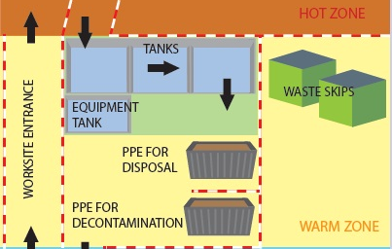
Typical Decon Layout
Source: OSRL
CGPRT(W) : Ensuring Clean Seas and Coasts in Western Region ……

Slide 25
Decon − Personnel
Decon facilities set up for responders
Remove oiled PPE in a controlled environment
Washing facilities
Storage facilities for cleaned PPE and clean clothing
Waste facilities for disposable PPE
Proper decon facilities for PPE means it stays in good conditon longer, is more cost effective and reduces strain on the supply chain
CGPRT(W) : Ensuring Clean Seas and Coasts in Western Region ……

Slide 26
Decon − Personnel
Avoid contamination contact
Practice good hygiene and decontamination procedures
Understand the product characteristics and use PPE appropriately
CGPRT(W) : Ensuring Clean Seas and Coasts in Western Region ……

Slide 27
Decon − Personnel
Important for personnel to use proper PPE and decon procedures to avoid:
Inhalation − Respiratory protection during initial response (vapours) and while pressure washing (mists)
Ingestion − Wash up prior to eating and drinking (smoking)
Aspiration − Fall into product and or during mist generation
Absorption − Direct skin contact usually through improper glove/sleeve interface
CGPRT(W) : Ensuring Clean Seas and Coasts in Western Region ……

Slide 28
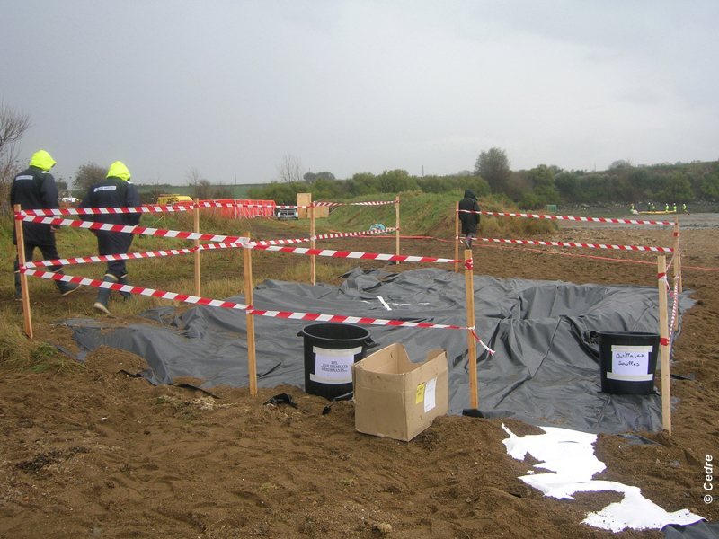
Control Entrance/Exit
Source: CEDRE
CGPRT(W) : Ensuring Clean Seas and Coasts in Western Region ……

Slide 29
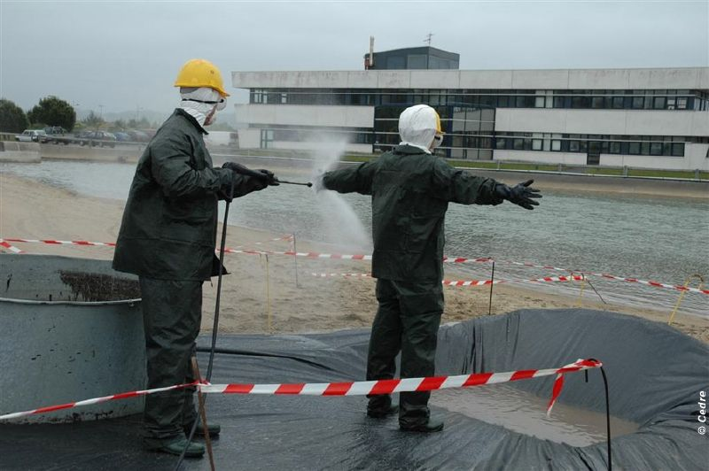
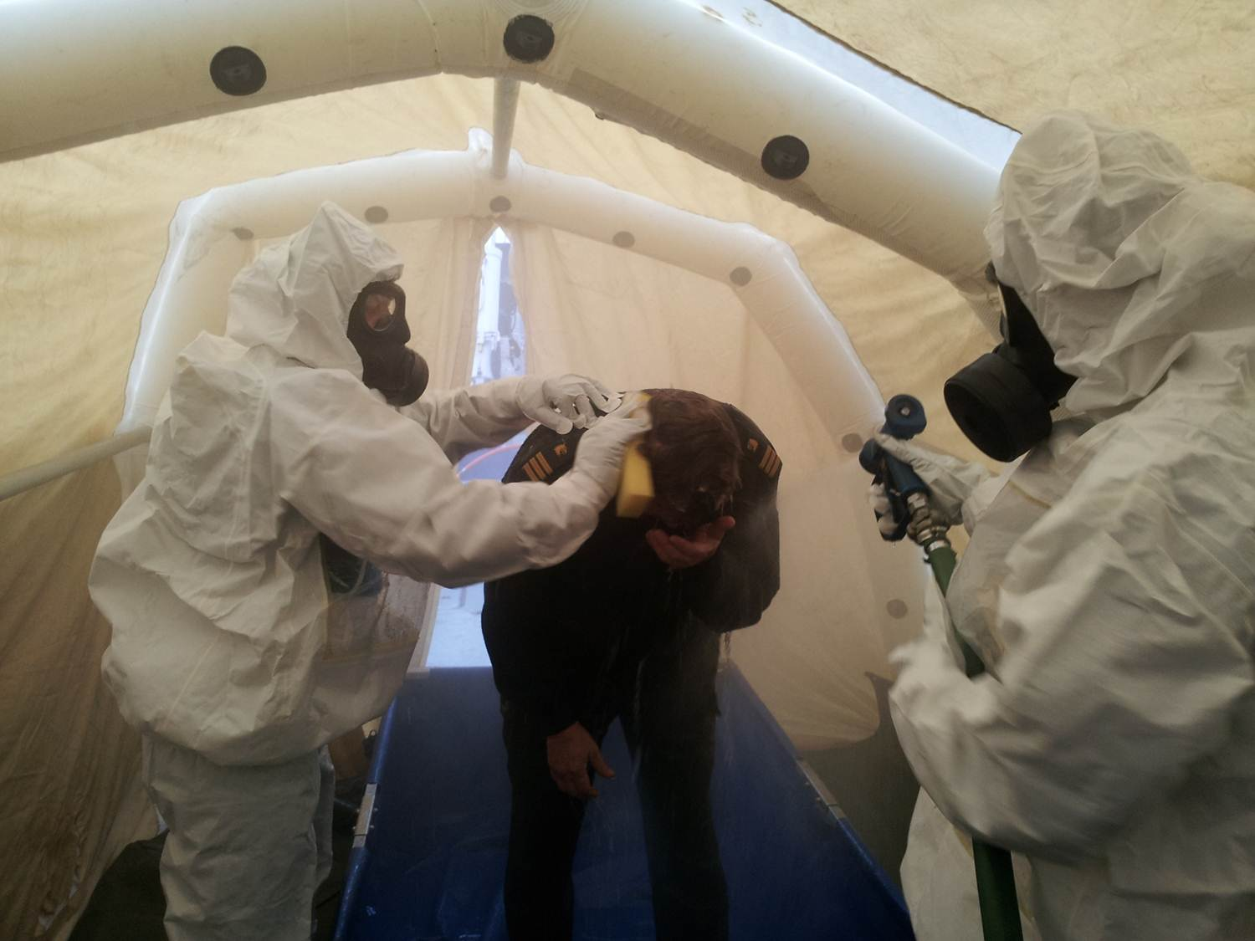
Decon
Source: CEDRE
Source: Swedish Coast Guard
CGPRT(W) : Ensuring Clean Seas and Coasts in Western Region ……

Slide 30
Vehicles and Heavy Equipment
Important to avoid secondary contamination by vehicles.
Transport cleaning stations need to be set up to prevent oil from being transferred to roads or other public places.
A lined containment area where vehicles can drive onto and be cleaned, including tyres.
CGPRT(W) : Ensuring Clean Seas and Coasts in Western Region ……

Slide 31
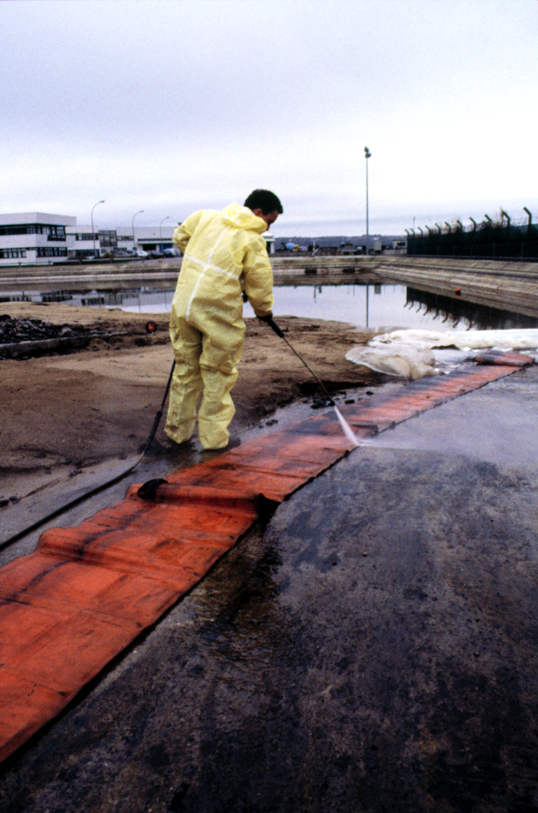
Decon
Source: CEDRE
CGPRT(W) : Ensuring Clean Seas and Coasts in Western Region ……

Slide 32
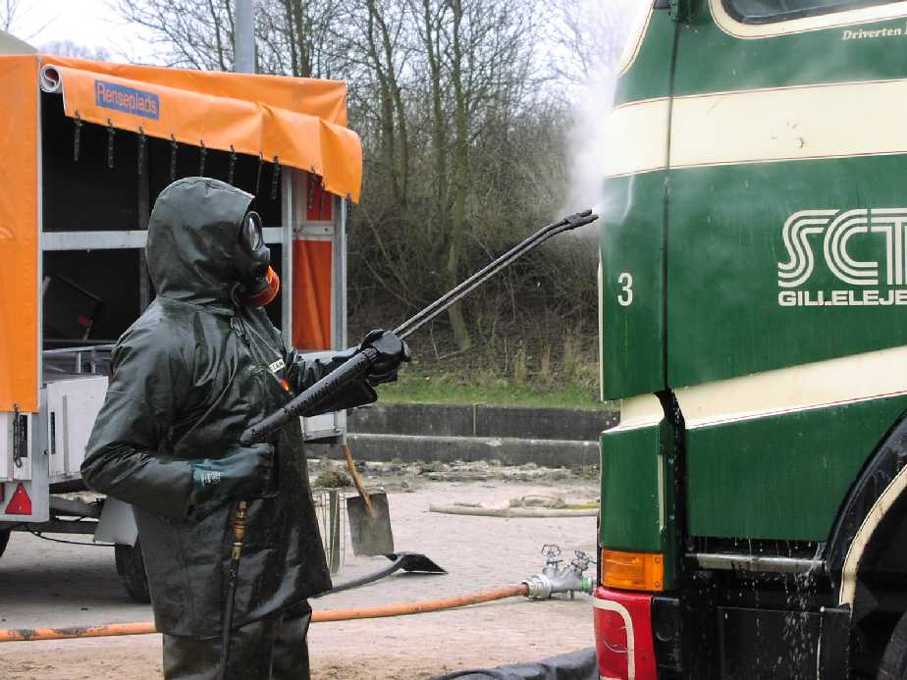
Equipment Cleaning
CGPRT(W) : Ensuring Clean Seas and Coasts in Western Region ……

Slide 33
Vessels
Oiled vessels must be kept in a “hot” area during spill operations that should be boomed to prevent contamination of clean areas.
Boom gates can be used to allow vessels to move between boomed areas.
Vessels must be decontaminated when ready to demobilize or move vessel to another location.
CGPRT(W) : Ensuring Clean Seas and Coasts in Western Region ……

Slide 34
Vessels
Vessel washing stations can be set up with lined containment areas to clean hull and decks.
Oily wash water must be contained and collected.
CGPRT(W) : Ensuring Clean Seas and Coasts in Western Region ……

Slide 35
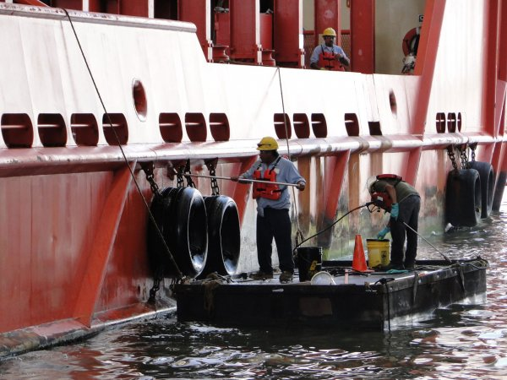
Vessel-on-Water
CGPRT(W) : Ensuring Clean Seas and Coasts in Western Region ……

Slide 36
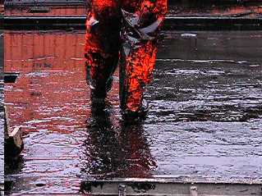
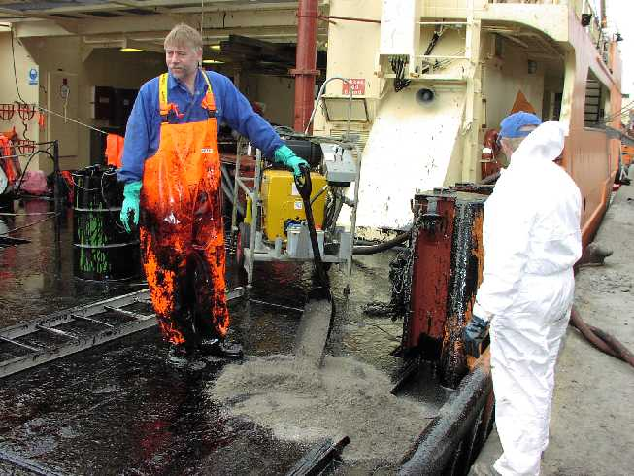
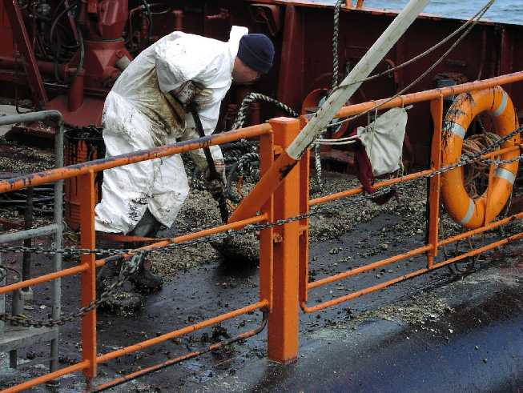
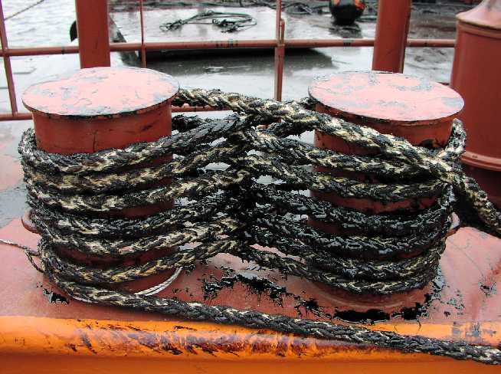
Heavily oiled ships
Heavily oiled ships
Adding sand….
Scraping oil from deck
CGPRT(W) : Ensuring Clean Seas and Coasts in Western Region ……

Slide 37
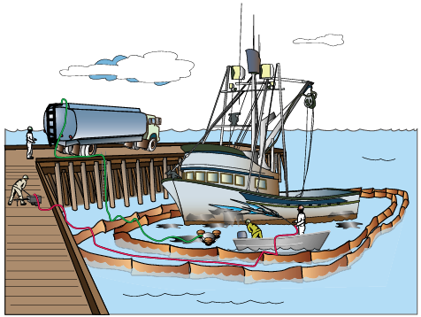
Small Craft - On Water
CGPRT(W) : Ensuring Clean Seas and Coasts in Western Region ……

Slide 38
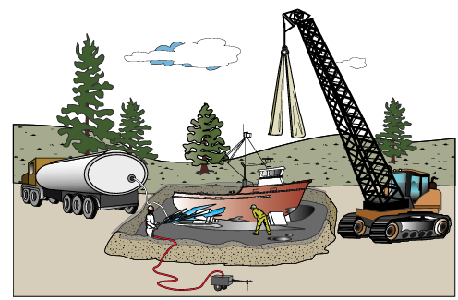
Small Craft - On land
CGPRT(W) : Ensuring Clean Seas and Coasts in Western Region ……

Slide 39
Organization and Tasks of a Clean-up Operation
A beach supervisor is appointed
Work forces of max. 10 people
Team leader for each group
Team leaders refer to beach supervisor
Each team has special functions/beach section
Activities must be clearly defined
CGPRT(W) : Ensuring Clean Seas and Coasts in Western Region ……

Slide 40
Team Leader Guidelines
Make record of all works carried out: report to beach supervisor.
All personnel must wear protective work clothes and other safety equipment.
Team leader responsible for team following safety and health regulations.
CGPRT(W) : Ensuring Clean Seas and Coasts in Western Region ……

Slide 41
Beach Supervisor Guidelines
Provision of all equipment required
Breaks, refreshments
Control of all vehicle traffic
Cleaning of all equipment after use and making ready for next day
Ensuring that all personnel have received full operational safety briefing
Keeping public at safe distance
Contact with the mass media (if authorized)
CGPRT(W) : Ensuring Clean Seas and Coasts in Western Region ……

Slide 42
Making an Operational Plan
Beach supervisor must:
agree with OSC the acceptable cleaning status to be achieved;
specify tasks for each team;
outline procedures to be followed for each team;
specify equipment to be used;
designate vehicle traffic and storage areas;
define working periods;
ensure safety checklist is given to team leaders.
CGPRT(W) : Ensuring Clean Seas and Coasts in Western Region ……

Slide 43
Health and Safety Requirements
Beach supervisors and team leaders:
Communication systems defined and checked
Tools not left scattered on beach
Routes for trucks defined
All work areas illuminated during operations
All personnel equipped with safety clothing
All personnel briefed on safety hazards
If explosion risk, all equipment is spark-free or explosion safe (e.g. motors, diesel engines)
CGPRT(W) : Ensuring Clean Seas and Coasts in Western Region ……

Slide 44
Health and Safety Requirements
Team leaders and beach supervisors:
If chemicals used, PPE must be available (eye washes, masks, etc.).
Proper cleaning and maintenance of all equipment must be carried out.
Familiarity with safety procedures in case of injury.
Pump and skimmer personnel instructed about proper use and potential risks and hazards.
CGPRT(W) : Ensuring Clean Seas and Coasts in Western Region ……

Slide 45
Conclusions
Logistics is critical to the response effort.
The supply chain must maintained to avoid “bottlenecks” − even small breaks in this chain can suspend operations e.g. fuel or drinking water.
Staging and decontamination facilities are required immediately to allow personnel to safely leave the spill site and to maintain equipment.
Shoreline workers must understand their role and task and work together safely.
CGPRT(W) : Ensuring Clean Seas and Coasts in Western Region ……

Slide 46
Any questions?
CGPRT(W) : Ensuring Clean Seas and Coasts in Western Region ……

